Slide 1



Rwanda IFMIS Implementation Experience
Presented by:
Marcel Mukeshimana
Accountant General

Slide 2
Agenda
1
E-Governance: Public Sector Services Automation
2
Current PFM e-Service Delivery Ecosystem
IFMIS: The Core of PFM Automation
3
Key values delivered by PFM Systems
4
IFMIS Systems toward vision 2050
5
Challenges and Risk mitigation strategies
1

Slide 3

Slide 7
E-Governance:
Public Sector Automation
PFM Systems
G2C
G2E
G2G
G2B
When we use the term e-Governance, we mean the use of information and communication technologies (ICT) to promote more efficient and effective government, facilitate more accessible government services, allow greater public access to information and make government more accountable to citizens. E-Governance involve delivering services via the Internet, telephone, community centers (self-service or facilitated by others), wireless devices or other communications systems.
E-governance is the digital transformation in the delivery of services between government institutions or agencies (G2G), citizens (G2C), employees (G2E) and businesses (G2B).
Digital service delivery reduces inefficiencies in public service delivery, increases accountability and reduces corruption through transparency, and empowers the citizen or business through access to information and services they need anywhere, anytime, resulting in e-governance.
This in turn boosts public satisfaction and engagement with the government and is directly correlated with the principles of good governance. Thus, e-governance is an enabler of good governance.
E-Governance
Government to
Citizens
Government to
Employees
12,385
Users
Government to
Government
Government to
Business
PFM Systems
E-Governance
4

Slide 4
Slide 7
Current PFM
e-Service Delivery Ecosystem
E-Tax
MNOs
IFMIS
Banks
Umucyo
IPPIS
SDMS
Irembo
e-traffic
PKI
Government to Government (G2G)
  Planning, Budgeting, Accounting, Treasury Management and Financial Reporting made simple and easier using IFMIS and SDMS web-based systems
Government to Employee (G2E)
  Time to pay employee reduced to a great extent through the integration of IFMIS, SmartHR and Banks
  Recruitment of employees made easier using e-recruitment of IPPIS
Government to Business (G2B)
  Bidding and contracting online via Umucyo and PKI
  Supplier registration and tax declaration made easier
Government to Citizens (G2C)
  Local government services, RNP services, Migration services, etc availed online using MNOs, Banks, Irembo, e-Tax, etc.
  National exam registration facilitated via SDMS, Irembo and Banks
12,385
Users
5

Slide 5
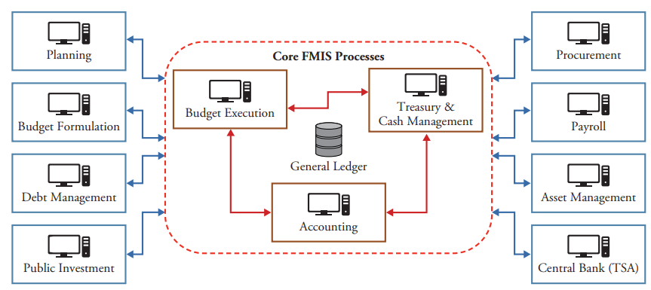
IFMIS: Design of a Typical From books
Financial management information systems (FMIS) can be broadly defined as a set of automation solutions that enable governments to plan, execute, and monitor the budget by assisting in the prioritization, execution, and reporting of expenditures, as well as the custodianship and reporting of revenues.
2

Slide 6




IFMIS Rwanda:
Development Dimensions
Institutional Coverage
G
System Administration
E-procurement
Users: Officers to Executives
Planning
Institutions: Ministries to Service Delivery Units
Functional Coverage
Reports
Budgeting
E-Banking (National Bank)
PFM Processes: Planning, Budget, Payments, Receivable, Accounting, Assets, Reporting, Interfacing, Business Intelligence, etc.
Commercial Banks
Assets & Inventory
Payment
Technology
E-Tax
Accounting
Receipts
Technology: Infrastructure and Connectivity; Software and Applications; Development, Deployment and Operations.
Payroll System
Software System = Users + Applications + Hardware
6

Slide 7


Slide 7
IFMIS:
Current Institutional Coverage of PFM Systems
172
BAs
Public Sector
6,566
Sites
Central
Government
Local
Government
Central Treasury (1)
Ministries and Agencies (172)
Development Projects (76)
Embassies and High Commissions (39)
Judicial Entities (41)
Kigali city (1)
Districts (30):
  Districts Hospitals (43)
  Sectors (416)
  Health centers (502)
  Public Schools (4,873)
16,151
Users
>20,144
Suppliers
7

Slide 8
Slide 7
Key Values
Realized via PFM Systems
Budget preparation and execution with focus on Value, Collaboration, Control, Accountability and Transparency
Efficient revenue using cashless options, with real-time reconciliation and accounting.
Transparent procurement with internationalized bidding rather than localized one
Accountants are becoming financial analysts rather than transaction entry clerks
1
2
3
4
5
6
7
Paperless, cashless, efficient, and transparent Treasury management
Time and cost saving using paperless financial reporting and consolidation tool
Cashless payment eliminated teller at BNR and with timely payment to employees, suppliers and other beneficiaries
8

Slide 9
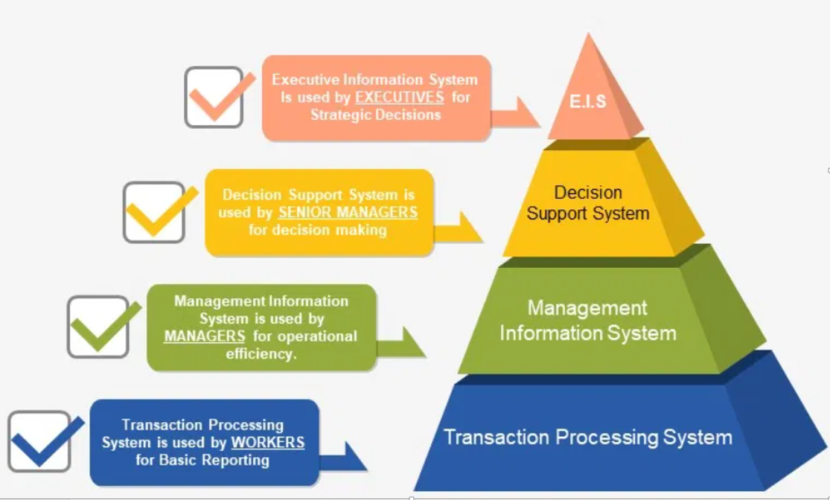
Slide 7
IFMIS Systems
Evolution
Functional expansion to all decentralized service delivery units.
Machine learning, Data Mining, Blockchain, Artificial Intelligence and other state of art technologies to be art the heart of improving service delivery, transparency and accountability in PFM systems.
Paperless and cashless policies will continue to drive the digitization of PFM services across all government service delivery units, with aim of self-service, any time, any where.
9

Slide 10
Slide 4
Automation Challenges
Human Challenges
Institution Challenges
IFMIS Functional Expansion
Lack of official guidelines, policies and procedures for institutions or departments that need business process automation.
Automation Cost vs ROI
Ownership and coordination between institutions: Education vs Finance (SDMS as one systems owned by two ministries), Health vs Finance (?), Infrastructure vs Finance (?)
Business Experts vs Computer Programmers: Language differences
Automation skills gap: The illusion of explanatory depth (IOED) is a cognitive bias where people believe that they understand a topic much better than they actually do.
External dependencies that may not allow to move to the required speed.
Cybersecurity
10

Slide 11
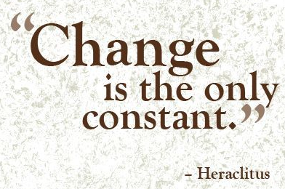
Slide 4
Risk mitigation
strategies
Rwanda’s progress is grounded in favorable transformational factors in the form of its visionary leadership as well as the results-based culture, home grown solutions, security, stability, law and order, and zero tolerance to corruption among others. PFM systems are founded on top of this political will.
Agility Software Development as the primary PFM Systems development methodology in order to cope with government dynamism and high technological changes.
IFMIS systems being developed in line within e-Government wide framework, strategies and policies.
IFMIS & SDMS
IFMIS Functional Expansion
The ability to adapt IFMIS to new changes is the key success factor.
4

Slide 12
Slide 4
Lessons Learned
In-house Development
In-house Development
IFMIS Functional Expansion
Use a domain-driven design approach to designing IFMIS.
In-house IFMIS is always cheaper than off-the-shelf IFMIS
Favor IFMIS process-based automation as opposed to data-entry tool.
Political will is the core factor to having in-house system.
In-house software development promote country’s internal capacity for self-development and sustainability.
Believe always in the capacity of internal resources.
Collaboration is key to achieving successful development of IFMIS.
10

Slide 13
THANK YOU
VISIT RWANDA
For detailed information or for any question on the presentation, please contact: marcel.mukeshimana@minecofin.gov.rw

